Slide 1
INSULATION STRATEGY & GUIDELINE
DRAFT
Global 7000 / 8000
May 2017

Slide 2
INSULATION STRATEGY & GUIDELINE
Table of content
TOPIC PAGES
Flammability Summary 3-4
Stress Summary 5
Weight Summary 6-7
M&P Summary 8-15
Methods Summary 16
Insulation & acoustics Summary 17-25
Supplier (Hutchinson) Summary 26-35
Engineering Summary 36-44
On going Investigation 45

Slide 3
INSULATION STRATEGY & GUIDELINE
Contact:
Marc-André Michaud
Phillip Brisebois
Flammability Summary
-Requirement:
- Insulation: 14 CFR 25.856(a)
Information:
-Insulation requirement is different and more critical than the cabinet requirement « 14 CFR 25.853(a) ».
-There is no small parts limitations or minimum spacing required for Velcro under the « 14 CFR 25.856(a) ».
-Limit as much as possible the creation of new insulation stack up to avoid new tests.
-Tests are quite expensive and not made in house. Therefore consult flammability team every time a new stack up is required.
Upcoming:
-FTV 4 Test plan: Estimated ECD: end of April 2017
-This test plan will provide the list of insulation stack up to burn.
- Upon creation of this list, it is recommended to all cabinet to review their next aircrafts
insulation packages to ensure conformity. If a discrepancy is found, consult Flammability team.
-LINK: Consult flammability group
-FTV 4 Test result: Estimated ECD: end of June 2017
-This list will provide the confirmation (Pass / Failed) for all stack ups.
-If failure, IPDT solution and change management will occur.

Slide 4
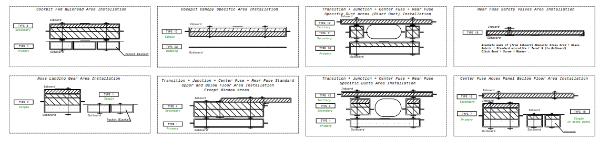
INSULATION STRATEGY & GUIDELINE
Contact:
Marc-André Michaud
Phillip Brisebois
Flammability Summary
Information:
Any combination of material stack up for flammability, in relation with Hutchinson material, should be part of PLP DWG. (EX: Shown below)
Any modification of stack up must trigger the validation with flammability. A creation of a new type in PLP will probably be required for certification purposes.

Slide 5
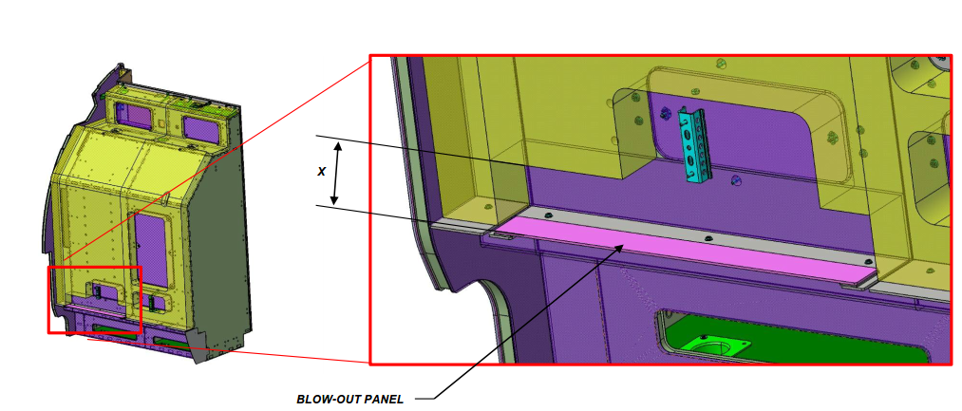
INSULATION STRATEGY & GUIDELINE
Contact:
Catherine Pho
Stress Summary
-Requirements:
- Insulation must not block decompression cutout or prevent blow-out panel movement.
- Dimension X is as per Stress requirement.
Information:
- Weights of insulation material is considered by Stress as part of the cabinet itself.
Decompression cutout

Slide 6

INSULATION STRATEGY & GUIDELINE
Contact:
David Stansfield
Nicolas Riou
Weight Summary
- General Requirements:
- All parts must be modeled and instantiated under the proper top assy structure.
-This is used in order to locate the parts and extract weight data from Catia using specialized Macros.
- Instances number must match the part number.
- If not, weight extraction macro will not work properly.
- Insulation must be included in the max weights of every cabinet.
- Specification sheet of each material must be available and must have a density.
- Whenever possible a volumetric density.
-See next slide for Catia/Enovia extra requirements
Information:
- Balance must be maintained between weight savings initiatives and acoustics / thermal requirements. Valid for creation of new concept and valid for change management impact evaluation.
-The material assignation to the part body is not used by weights extraction macros.
- EX:
Used only for 3D DMU color application.

Slide 7
INSULATION STRATEGY & GUIDELINE
Contact:
David Stansfield
Nicolas Riou
Weight Summary
-Weight calculation method requirements:
- The weight calculation methods may vary based on the type of part.
- Volumetric density method (easiest way)
-EX: Single material parts (aluminum, rigid foam, …)
- Surface density method (Weight per surface area) used whenever volumetric density is not available
-EX: Composite material parts (panel, …)
- Enovia/Catia attribute:
-Volumetric density method:
- « Material Specification Production », « Type » & « Class » must be properly filled.
- Surface density method
- « Thickness », « Material Specification Production », « Type » & « Class » must be properly filled.

Slide 8
INSULATION STRATEGY & GUIDELINE
Contact:
Joseph Verdino
Kim Tetley-Gerard
M&P Summary
-Requirements: - Insulation material for Blankets, Flextane, Deltane changed from ENM… to PLP…
Material | Thickness / old P/N | Hutchinson PLP Type | Comment
Blankets | ENM386596001B (.5”) | PLP410700000 Type 1 (.5”) | USE NEW PLP #
 | ENM386596002B (1.0”) | PLP410700000 Type 2 (1.0”) | USE NEW PLP #
 | ENM386596003B (2.0”) | PLP410700000 Type 3 (2.0”) | USE NEW PLP #
 | ENM386596004B (3.0”) | PLP410700000 Type 4 (3.0”) | USE NEW PLP #
 | ENM386596005A (.422”) | Development Required (Type 5 (.422”)) | Under investigation M&P
Flextane | FLEXTANE SA/1 (.024”) | PLP410700000 Type F1 (.024”) | USE NEW PLP #
 | FLEXTANE SA/2 (.047”) | PLP410700000 Type F2 (.047”) | USE NEW PLP #
 | FLEXTANE SA/4 (.098”) | Development Required (Type F3 (.098”)) | If ever needed.
Deltane | DELTANE 350 AL0.3 SA/1.6 (.039”) | Development Required (Type D2 (.039”)) | If ever needed.
 | DELTANE 350 AL0.5 SA/2.2 (.047”) | PLP410700000 Type D1 (.047”) | USE NEW PLP #
 | DELTANE 350 AL0.5 SA/2.9 (.067”) | Development Required (Type D3 (.067”)) | If ever needed.
Felt | BAMS 841-001 TY 6 GRADE 1 (plain back sheet) (.125”, .250”, .500”) | No development Planned (PLP type FT1 created but should be removed from DWG per M&P) | KEEP USING BAMS
 | BAMS 841-001 TY 6 GRADE 2 (Adhesive-Back sheet) (.250”, .500”) | No development Planned | KEEP USING BAMS

Slide 9
INSULATION STRATEGY & GUIDELINE
Contact:
Joseph Verdino
Kim Tetley-Gerard
M&P Summary
-Requirements:
- Blanket attachments Strategy: FASTENER, RECLOSABLE (APLIX)
- Self-adhesively bonded
- MUST ALSO BE STITCHED on ENM386596005A blankets (heavier).
-Information:
- Under investigation; ECD: TBD Marking process (e.g. Permanent Marker Dotted lines) to replace time consuming pre-cut process in felt.
- BAPS 730-014 is currently under revision process to realign procedures with latest requirements.
ECD: End of May 2017. Planned revision should include the following:
- Integration of supplier comments considering manufacturing limitations.
- EX: Drain & Venting holes, Process and tooling available, …
- Realignment of material list.
- Review of fasteners section.
EX: addition of Velcro stitching process and review of fastener sizes.
- Rephrasing of slits and cutouts, pre-fit / trimming sections.
Material | P/N | Comment
Fastener Reclosable | A840R0025H694SC (1.0” wide) (HOOK) | COLOR NATURAL WITH SELF-ADHESIVE
 | A840R0025L694SC (1.0” wide) (LOOP) | COLOR NATURAL WITH SELF-ADHESIVE

Slide 10
INSULATION STRATEGY & GUIDELINE
Contact:
Joseph Verdino
Kim Tetley-Gerard
M&P Summary
-Information:
- Some spec sheet may be found in following directory (if not contact M&P):
W:\m170 - wp4\WP 4.2.1 Cabinet\04. Materials and Processes

Slide 11
INSULATION STRATEGY & GUIDELINE
Contact:
Joseph Verdino
Kim Tetley-Gerard
M&P Summary
-Information: - Material Raw Size (for thickness, refer to previous slides)
Material | Part number | Width X Length | Comment
Blankets | ENMXXXXXXXXXX | 48” X 72”
 | ENM386596005A | 36.22” X 57.086” (920mm X 1450 mm)
 | PLP410700000 TYPE X | 48” X 72”
Flextane | FLEXTANE SA/X | 36.22” X 57.086” (920mm X 1450 mm) | *Self-Adhesive (SA in P/N)
 | PLP410700000 Type FX | 36.22” X 57.086” (920mm X 1450 mm) | *Self-Adhesive
Deltane | DELTANE 350 AL0.X SA/X.X | 19.685” X 19.685” (500mm X 500 mm) | *Self-Adhesive (SA in P/N)
 | PLP410700000 Type DX | 19.685” X 19.685” (500mm X 500 mm) | *Self-Adhesive
 |  | 19.685” X 39.370” (500mm X 1000 mm) | Newly available per Hutchinson Ref email attached in Supplier Section *Self-Adhesive
Felt | BAMS 841-001 TY X GRADE X | 48” Width - Roll | 1/8 thick is not available self-adhesive* * ¼ & ½ may be self-adhesive or not.
Fastener, Reclosable | A840R0025X694SC | 1.00” Width Roll | *Self-Adhesive

Slide 12

INSULATION STRATEGY & GUIDELINE
Contact:
Joseph Verdino
Kim Tetley-Gerard
M&P Summary
-Requirements for notes: - MBD of Blankets, Flextane, Deltane;
1. FINISH SPEC PER BAERD BA700-005.
2. FINISH CODES PER BAERD INT-001.
3. INTERPRET THIS DATASET PER ASME Y14.100 - 2000.
4. DIMENSIONS AND TOLERANCES PER ASME Y14.5 - 2009.
5. CATIA 3D DATASET ANNOTATIONS PER ASME Y14.41 - 2003.
X. FOR TYPE DEFINITION SEE PLP410700000.
X. MARKING PER PLP410700000.
X. INSULATING COMPONENT TOLERANCING PER PLP410700000.
X. BAEMM-001 IS NOT APPLICABLE TO THE MATERIAL SPECIFIED.
ADD Following only for Blankets only.
X. FABRICATE PER BAPS 730-014.
X. OVERALL SIZE AND FEATURES CAN BE UP TO 1.5% LARGER TO MEET INSULATION REQUIREMENTS
DO NOT USE THOSE NOTES.
X. IDENTIFY PER BAPS 144-005.
X. SEAM LINES ARE PERMISSIBLE.
X. ALL SURFACES TOLERANCE TO BE .

Slide 13

INSULATION STRATEGY & GUIDELINE
Contact:
Joseph Verdino
Kim Tetley-Gerard
M&P Summary
-Requirements for notes:
- MBD of felt;
1. FINISH SPEC PER BAERD BA700-005.
2. FINISH CODES PER BAERD INT-001.
3. INTERPRET THIS DATASET PER ASME Y14.100 - 2000.
4. DIMENSIONS AND TOLERANCES PER ASME Y14.5 - 2009.
5. CATIA 3D DATASET ANNOTATIONS PER ASME Y14.41 - 2003.
X. IDENTIFY PER BAPS 144-005.
X. TOLERANCE FOR PERIPHERY, CONTOUR AND CUTOUT IS .
DO NOT USE THOSE NOTES.
X. Any note referring to BAPS 188-001 or BAPS 188-000.
X. SEAM LINES ARE PERMISSIBLE. (felt part are also being outsourced therefore controlling the “re-attachment” of pieces together or the re-identification of all pieces generates production issues.)

Slide 14
INSULATION STRATEGY & GUIDELINE
Contact:
Joseph Verdino
Kim Tetley-Gerard
M&P Summary
-Requirements for notes:
- Assembly / Installation;
1. FINISH SPEC PER BAERD BA700-005.
2. FINISH CODES PER BAERD INT-001.
3. INTERPRET THIS DATASET PER ASME Y14.100 - 2000.
4. DIMENSIONS AND TOLERANCES PER ASME Y14.5 - 2009.
X. INSTALLATION AND REWORK OF BLANKETS PER BAPS 730-014.
X. BLANKET MAX ALLOWABLE COMPRESSION IS 20% OF OVERALL BLANKET THICKNESS.
X. IT IS PERMISSIBLE TO MAKE SLITS AND CUTOUTS IN FELT AND DAMPING MATERIAL PARTS TO CLEAR INTERFERING COMPONENTS. SLITS AND CUTOUTS SHALL BE MINIMAL IN SIZE TO PREVENT NON-INSULATED AREAS.
Add when using self-adhesive material (some felt, Deltane or Flextane)
FLAG X. CLEAN FAYING SURFACE PER BAPS 180-009 AND BOND USING SELF ADHESIVE.
Add to bond non self-adhesive material (felt)
FLAG X. BOND PER BAPS 700-002 TYPE 1.

Slide 15
INSULATION STRATEGY & GUIDELINE
Contact:
Joseph Verdino
Kim Tetley-Gerard
M&P Summary
-Requirements for notes:
- Assembly / Installation (continued);
Do not use:
X. INSULATION COMPONENTS MAY BE SPLIT INTO MANY SUB-PARTS IN ORDER TO ACHIEVE THE INSTALLATION.
Special limited usage notes. Use under special context. Must be authorized by methods.
X. IT IS PERMISSIBLE TO CUT FELT PARTS (BAMS 841-001) IN TWO SECTIONS TO FACILITATE INSTALLATION.
- Instead of using this note, adapt design to make logic split in parts.
That way, recurring production time can be avoided. If design can`t be adapted, discuss the impacts with methods. Note is inherited from FTV4 preliminary designs used normally to clear big obstacles such as dividers”. Moving forward with maturity of design note should disappear.
Pre-cuts felt FLAG X. AREA SURROUNDED BY DISCONTINUOUS CUTOUTS IS TO BE REMOVED PRIOR TO INSTALLATION IF TEMPERATURE SENSOR IS TO BE INSTALLED
FLAG X. AREA SURROUNDED BY DISCONTINOUS CUTOUTS IS TO BE REMOVED PRIOR TO INSTALLATION IF SUBWOOFER IS TO BE INSTALLED.
- Those notes might disappear completely after M&P investigation on permanent marker process. Process may be simplified to mark up dotted lines unless “manufactured”.

Slide 16
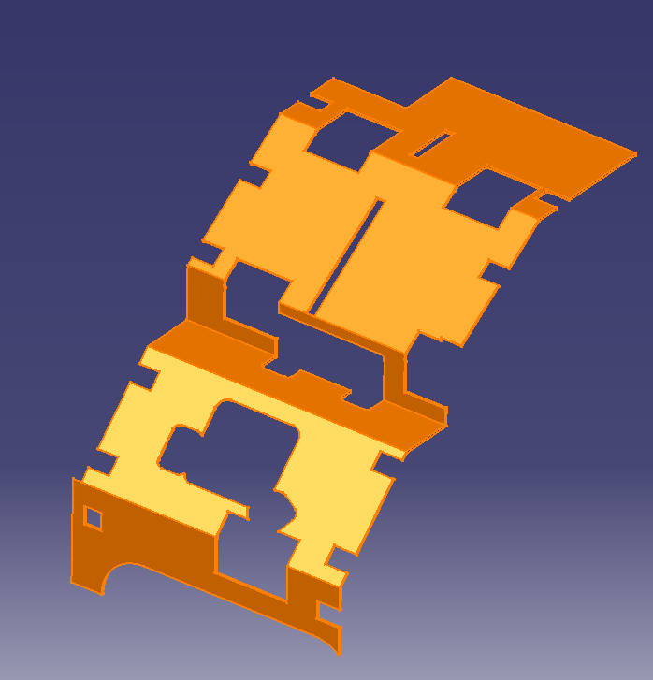
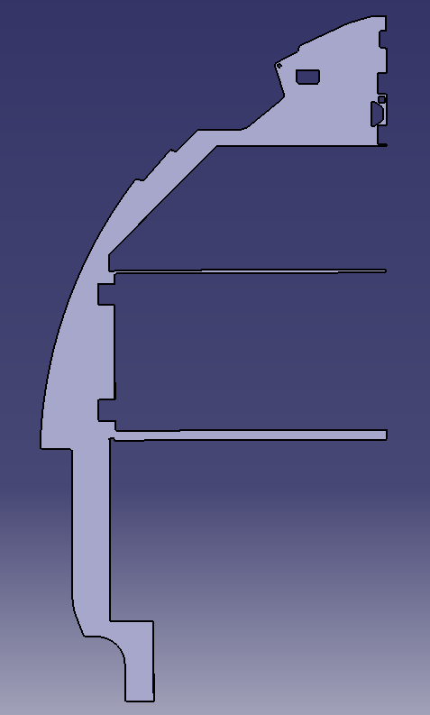
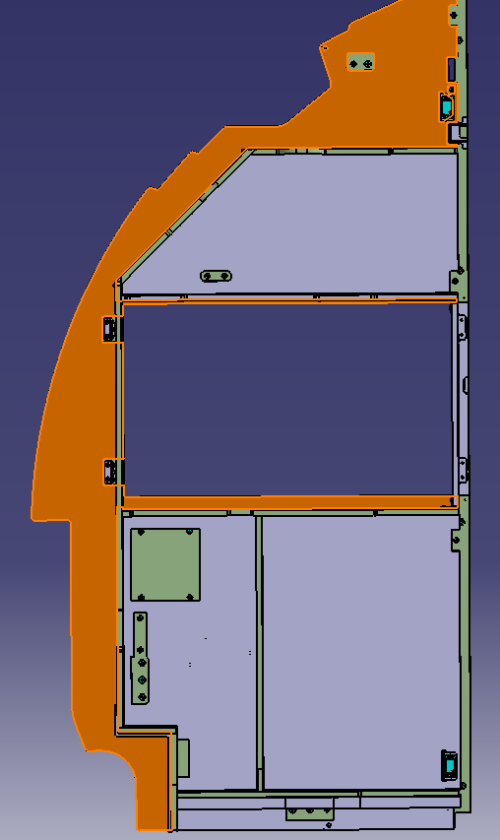
INSULATION STRATEGY & GUIDELINE
Contact:
Isabelle Ayotte
Methods Summary
-Requirement:
- Installation workbook Only + all detail covered by BAPS (ex: Velcro application)
- Tolerances for cutout ¼ on blankets and 1/8 on other or per suppliers requirements.
Information:
- Slits in insulation components will be made in house.
- Most of manufacturing of insulation detail parts are outsourced.
- When stitching of Velcro is required, it is generally made as shown
- Position and type of stitch is currently up to production. - Limitations should be added in upcoming BAPS 730-014 rev.
- Drain & venting holes will be made by supplier in purchased blankets.
- Parts must be modeled within range of raw material and should be divided logically to minimize waste and ease installation. Very thin wall should be avoided as much as possible.
Easier to produce and install if split in 2 or more separate parts. Also keep as much as possible min .500” wall for felt parts. Discuss with methods if less than .500” is really needed for acoustics.

Slide 17

INSULATION STRATEGY & GUIDELINE
Contact:
Vincent Pointel
André Brodeur
Insulation & acoustics Summary

Slide 18
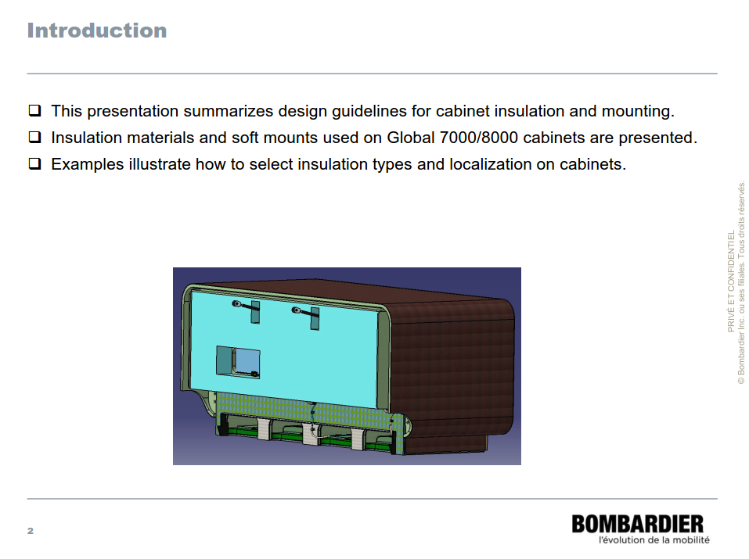
INSULATION STRATEGY & GUIDELINE
Contact:
Vincent Pointel
André Brodeur
Insulation & acoustics Summary

Slide 19
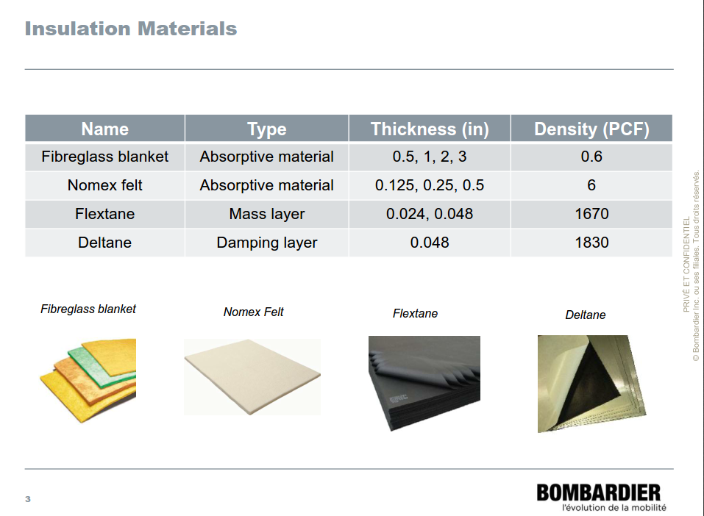
INSULATION STRATEGY & GUIDELINE
Contact:
Vincent Pointel
André Brodeur
Insulation & acoustics Summary

Slide 20
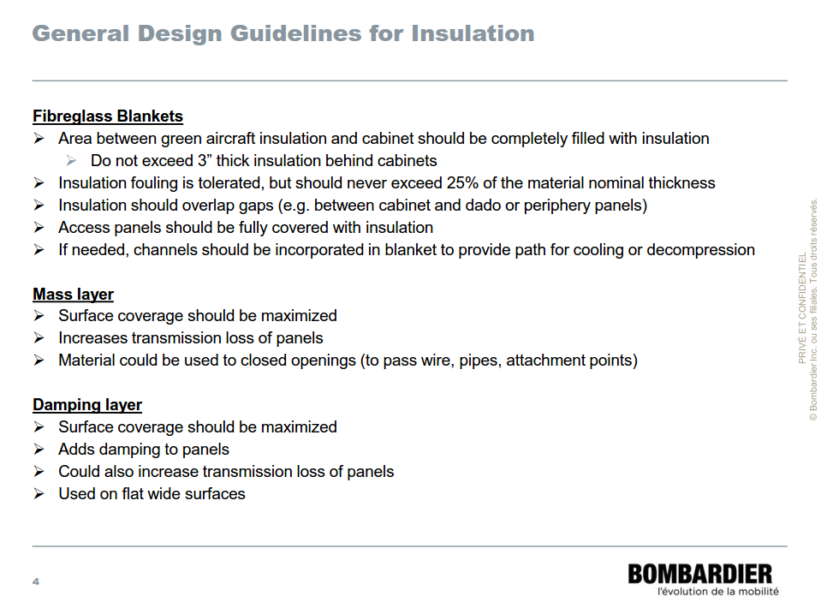
INSULATION STRATEGY & GUIDELINE
Contact:
Vincent Pointel
André Brodeur
Insulation & acoustics Summary

Slide 21
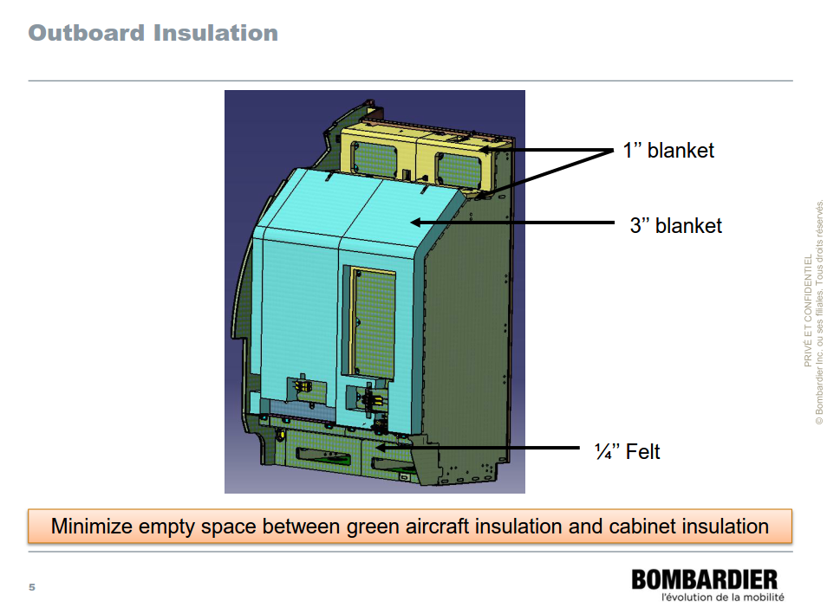
INSULATION STRATEGY & GUIDELINE
Contact:
Vincent Pointel
André Brodeur
Insulation & acoustics Summary

Slide 22
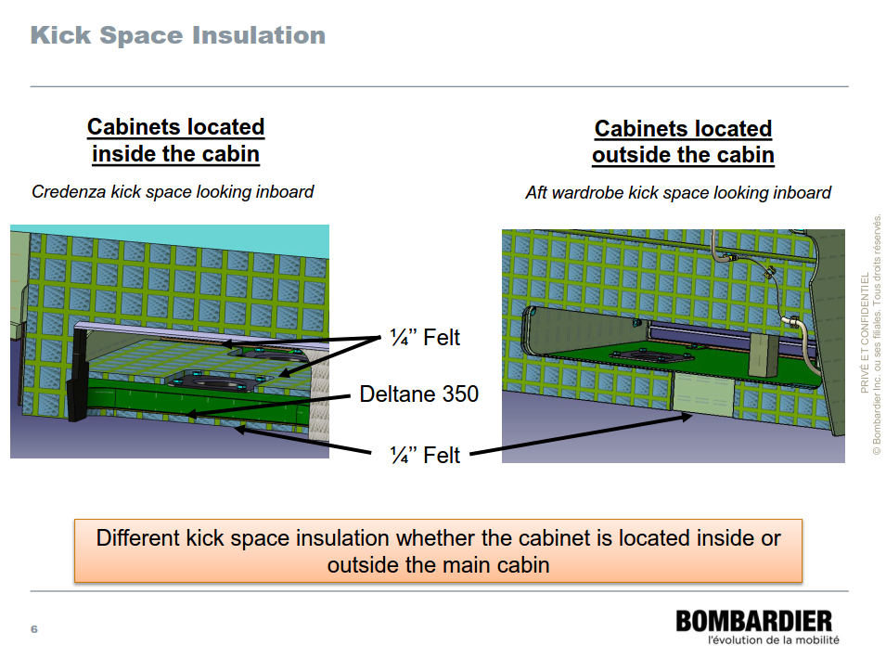
INSULATION STRATEGY & GUIDELINE
Contact:
Vincent Pointel
André Brodeur
Insulation & acoustics Summary

Slide 23
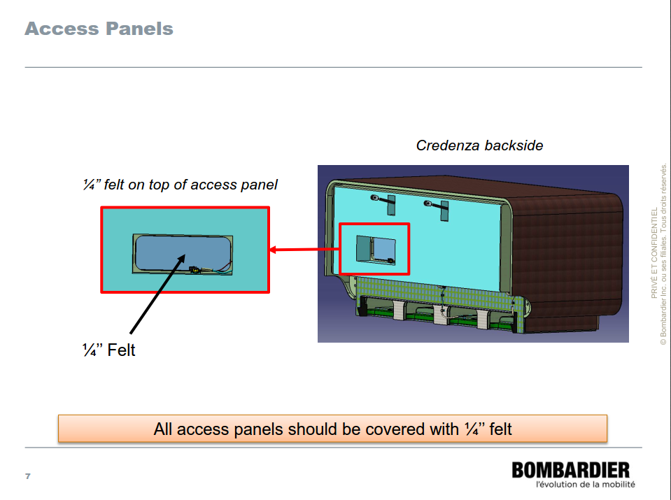
INSULATION STRATEGY & GUIDELINE
Contact:
Vincent Pointel
André Brodeur
Insulation & acoustics Summary

Slide 24
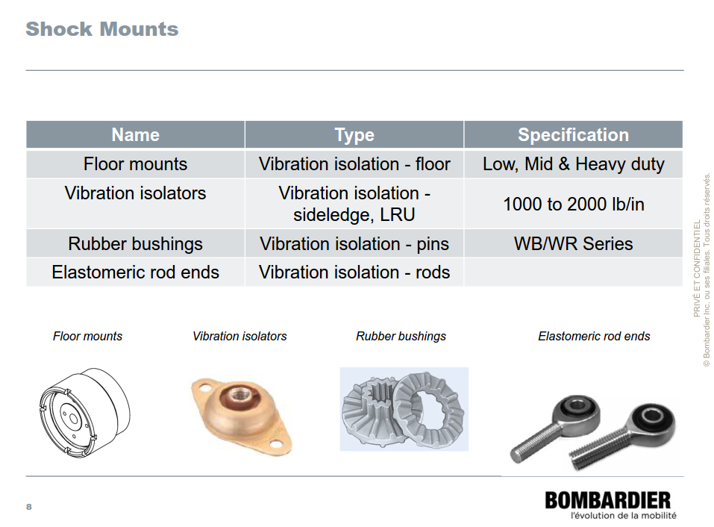
INSULATION STRATEGY & GUIDELINE
Contact:
Vincent Pointel
André Brodeur
Insulation & acoustics Summary

Slide 25
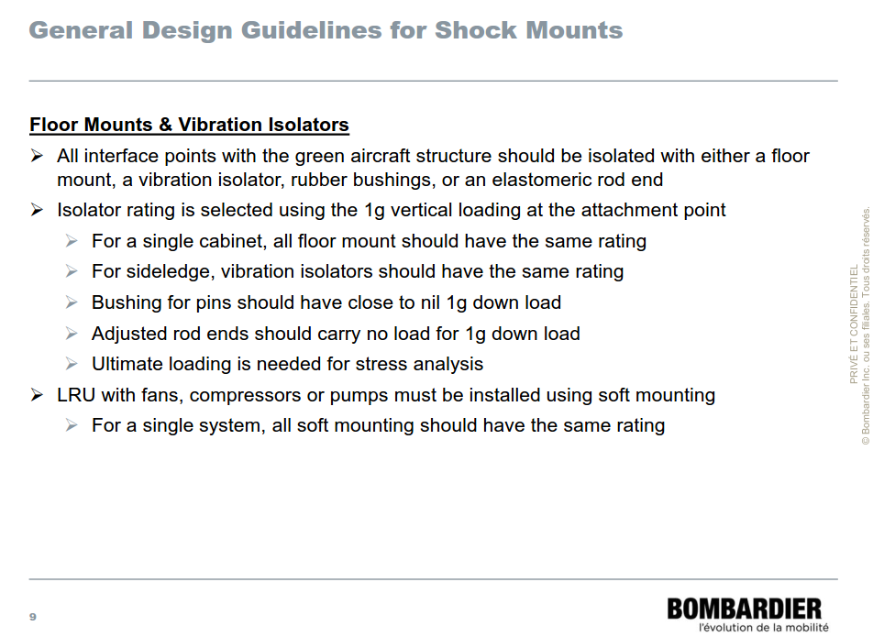
INSULATION STRATEGY & GUIDELINE
Contact:
Vincent Pointel
André Brodeur
Insulation & acoustics Summary

Slide 26
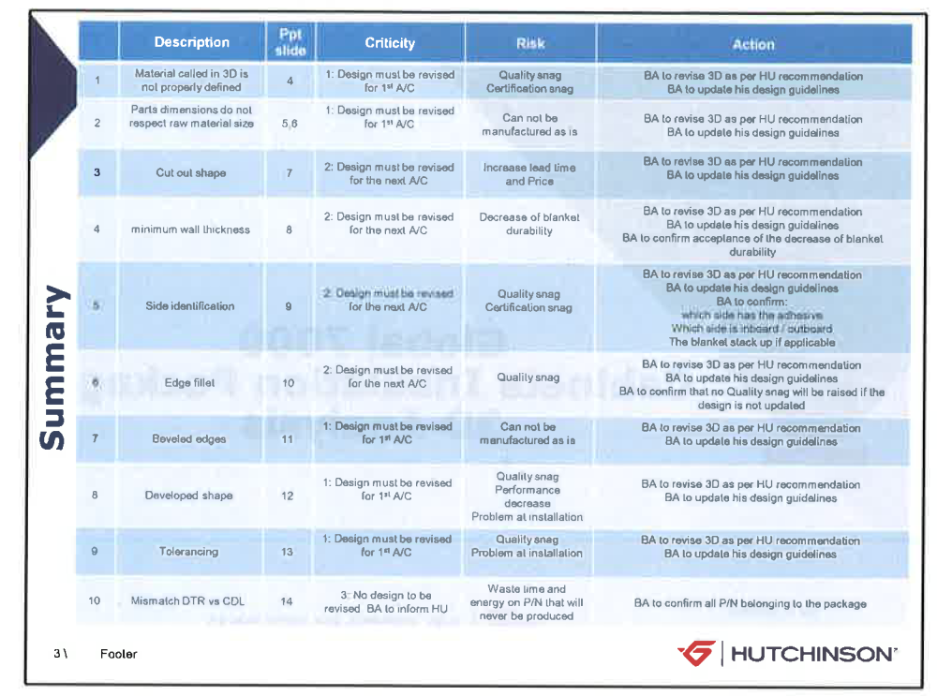
INSULATION STRATEGY & GUIDELINE
Contact:
Gwendal.Nicolas@hutchinsonna.com
Supplier (Hutchinson) Summary
-Requirement / Known Issues:
References:
RFC 48334
INSULATION SNAG FROM HUTCHINSON
RFC 48477
INSULATION SNAG FROM HUTCHINSON NLA-UP

Slide 27
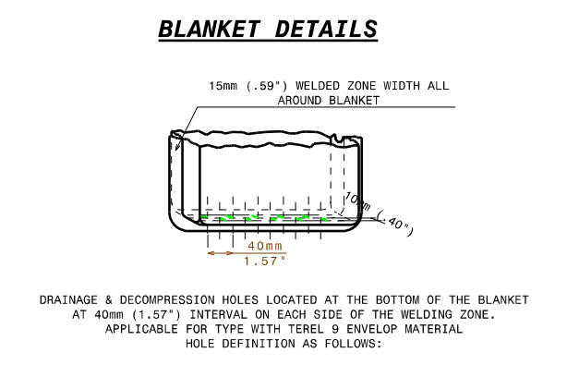
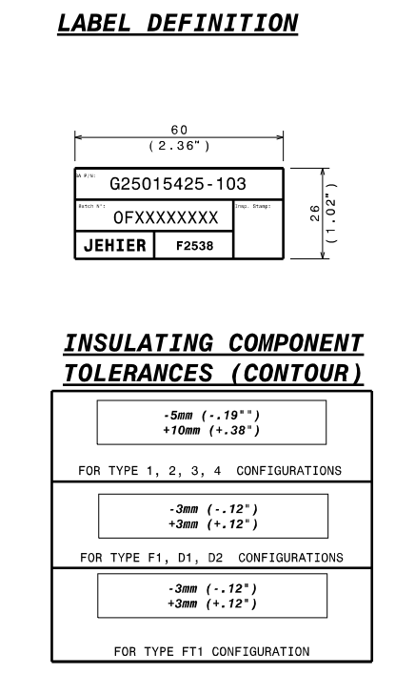
INSULATION STRATEGY & GUIDELINE
Contact:
Gwendal.Nicolas@hutchinsonna.com
Supplier (Hutchinson) Summary
Information:
- Conolite: Material is not in Hutchinson Scope of Material
- ENMXXXX blankets are transferred to PLPXXXX material specification since ENMXXXX define actual parts and does not define a material specification.
Risk avoided by such;
- ENMXXXX constraint the design and may generate issues for future design.
- Problem to link the design to certification requirements.
- BA – HU quality snags.
-Information on label size and drain/venting hole may be found in PLP DWG.

Slide 28
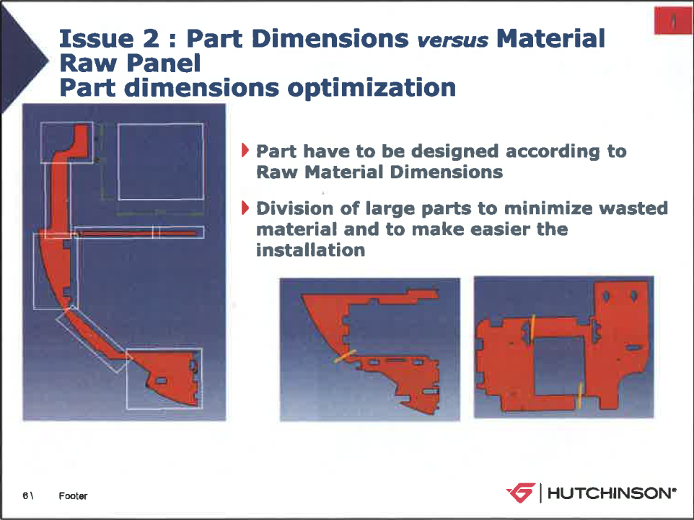
INSULATION STRATEGY & GUIDELINE
Contact:
Gwendal.Nicolas@hutchinsonna.com
Supplier (Hutchinson) Summary
Information:
- Parts must be modeled within range of raw material and should be divided logically to minimize waste and ease installation.
RAW Material

Slide 29
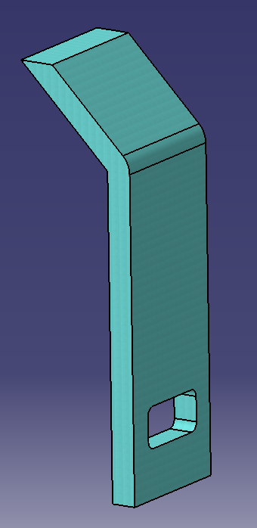
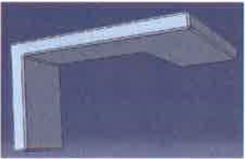

INSULATION STRATEGY & GUIDELINE
Contact:
Gwendal.Nicolas@hutchinsonna.com
Supplier (Hutchinson) Summary
Manufacturing Limitations and Particularities:
General: - Manufacturing will be using BA MBD. One part per model. Attachments & slits will be done at BA.
- Flat pattern will be done by Hutchinson; not BA.
- Insulation parts should never be modeled with edge fillet since it does not represent reality.
- Insulation parts should never be modeled beveled since it can not be manufactured.
Edges should always be Straight (90 deg).
- Insulation Blanket are bigger in free state that they are in installed condition. For enhance performance, the blanket will be lightly compressed in order to fit in the cavity. BA-3D will be modeled « as installed » and therefore the following note will be added.
X
AVOID

Slide 30
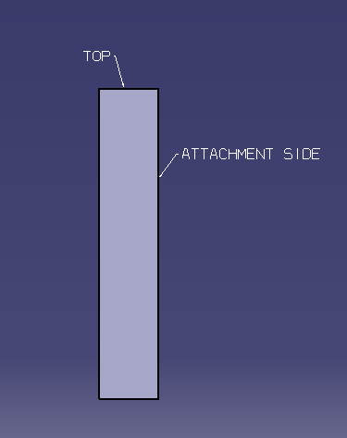
INSULATION STRATEGY & GUIDELINE
Contact:
Gwendal.Nicolas@hutchinsonna.com
Supplier (Hutchinson) Summary
Manufacturing Limitations and Particularities:
-General:
- First version of BA-3D models did not identified the location of drain & venting holes.
- To solve the issues, BA-3D model must have a annotation
to show the TOP of the blanket.
- First version of BA-3D models did not identified the face in contact with the cabinet causing issues such as:
- Self-adhesive may be on wrong side.
- Reclosable attachment may be on wrong side.
- Identification label may be on wrong side.
- To solve the issues, BA-3D model must have a annotation
to show the attachment side.

Slide 31

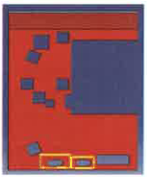

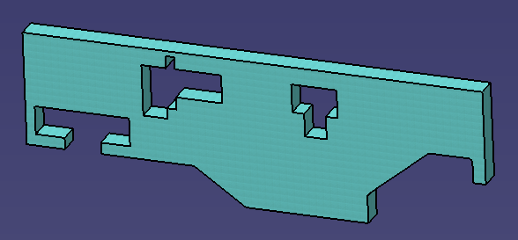
INSULATION STRATEGY & GUIDELINE
Contact:
Gwendal.Nicolas@hutchinsonna.com
Supplier (Hutchinson) Summary
Manufacturing Limitations and Particularities:
- Blankets
- Limit use of reduction in thickness of blankets (hard to manufacture)
- Cutouts geometry and internal corners should always be squared / sharp.
*Round cutouts are difficult, long and expensive to produce. They generate quality issues without enhancing the insulation performances of blankets.
Transform round and ellipse in square and rectangular, keep corner sharp.

Slide 32
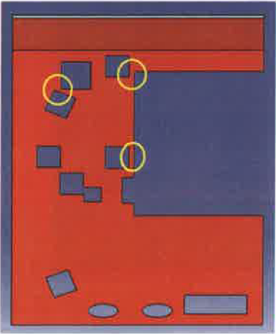
INSULATION STRATEGY & GUIDELINE
Contact:
Gwendal.Nicolas@hutchinsonna.com
Supplier (Hutchinson) Summary
Manufacturing Limitations and Particularities:
- Blankets
- Minimum wall thickness of blanket should be 2”. Under that value, the blanket will be fragile and less durable. Production cost and lead time may also increase.
- Under special circumstances wall thickness can be manufactured with an absolute minimum wall thickness of 1”. Supplier should be consulted for such usages.
Use
Minimum 2” Wall

Slide 33
INSULATION STRATEGY & GUIDELINE
Contact:
Gwendal.Nicolas@hutchinsonna.com
Supplier (Hutchinson) Summary
Manufacturing Limitations and Particularities:
- Blankets - Damping Material (Flextane, Deltane)
- Tolerances to be -.19” +.38” per PLP DWG. - Tolerances to be +/- .12” per PLP DWG.

Slide 34

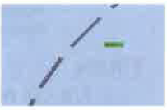
INSULATION STRATEGY & GUIDELINE
Contact:
Gwendal.Nicolas@hutchinsonna.com
Supplier (Hutchinson) Summary
Manufacturing Limitations and Particularities:
- Damping Material (Flextane, Deltane)
- Slit is never a proper way to make a cutout, proper cutouts should be modeled.
* Cutout should be squared or as a hole.*
- If ever pre-cut are required Hutchinson shall be consulted and width of
pre-cut will never be ¼ wide but only the size of the blade.
X
AVOID

Slide 35
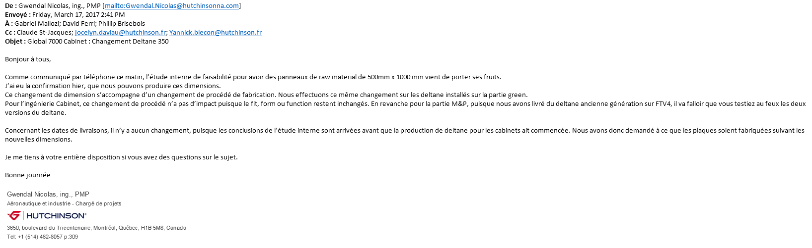
INSULATION STRATEGY & GUIDELINE
Contact:
Gwendal.Nicolas@hutchinsonna.com
Supplier (Hutchinson) Summary
Manufacturing Limitations and Particularities:
- Damping Material (Flextane, Deltane)
- New « Deltane » raw material size available.

Slide 36
INSULATION STRATEGY & GUIDELINE
Contact:
Gabriel Mallozi
Marc Larochelle Legrand
Eng. Rules Summary
-Requirement: Pages
- Section 1: Overall Insulation Strategy & History 37-38
- Section 2: Requirements and methodology 39-43
- General 39-40
- 3D & Design requirements 41-42
- 2D, Drafting & Attributes 43
- Section 3: Sideledge & Dados methodology 44
- Under development

Slide 37
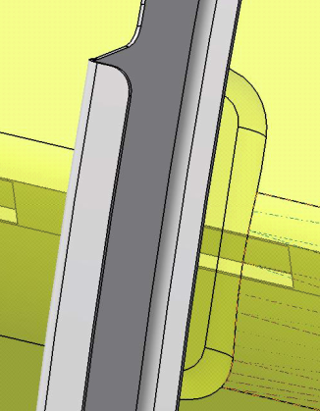
INSULATION STRATEGY & GUIDELINE
Contact:
Gabriel Mallozi
Marc Larochelle Legrand
Eng. Rules Summary: Section 1
-Overall Insulation Strategy & History:
- Phase 0 (summary): February 2016 (completed)
- Initializing the engineering design of the insulation blankets. First ACFT production kept in house.
- Wardrobe was used as pilot project for FTV4 development.
- Initializing the DMU requirements and methodology for insulation items.
- One part per insulation item
- Partially define 3D model. Shape, contour and main cutouts only. Outsourced potential.
- 1 Insulation installation per cabinet
- 1/8 clearance around component for cutouts including access panel brackets.
- Slits & minor cutouts to be done in production
- 20% compression ratio authorized
- No flexible model required to « avoid 3D clash »
- Phase 1: Q1-Q2 2017 (current) *except for sideledges dado for Demo ACFT.
- Refining the engineering design of the insulation blankets.
- Outsourcing strategy development.
- Refining the requirements (DMU, 2D,…) and methodology for insulation items

Slide 38
INSULATION STRATEGY & GUIDELINE
Contact:
Gabriel Mallozi
Marc Larochelle Legrand
Eng. Rules Summary: Section 1
- Phase X: Future potential development.
- Standardize more all cutouts and slits made out in production.
- Better control of variations and options.
- Possibility to outsource slits, cutouts and attachments
- Miscellaneous improvements
- RFC and/or lessons learnt

Slide 39
INSULATION STRATEGY & GUIDELINE
Contact:
Gabriel Mallozi
Marc Larochelle Legrand
Eng. Rules Summary: Section 2
Phase 1: Requirements and methodology
General
- Respect requirements for all groups mentioned in this documents (technical, suppliers, …)
*For simplification, when required, requirements will be duplicated in this section but explanation will remains in respective group sections.
PG 3, 4 - Numerous stack up should be limited as much as possible, any modification must go through Flammability groups for impacts analysis.
PG 5 - Insulation parts must not block decompression cutout or prevent blow-out panel movement.
PG 6, 29 - One part per insulation item with proper 3D & MBD detailing (attributes, notes, …)
PG 6 - One insulation installation drawing per cabinet called under top assy. Respect product structure and instances numbering.
PG 8 to 11 - Use approved materials. (Blankets, Damping materials, felt) & always design within range
of raw material sizes. (PLP, BAMS 841)
PG 16, 20, - To limit acoustic losses, blankets need to be modeled in single pieces, when possible.
28 However, to minimize waste of material, consider a logic division. Limit the use of small blankets.
PG 20 to 23- Install insulation materials on back of cabinet as well as bottom following acoustics guidance.

Slide 40
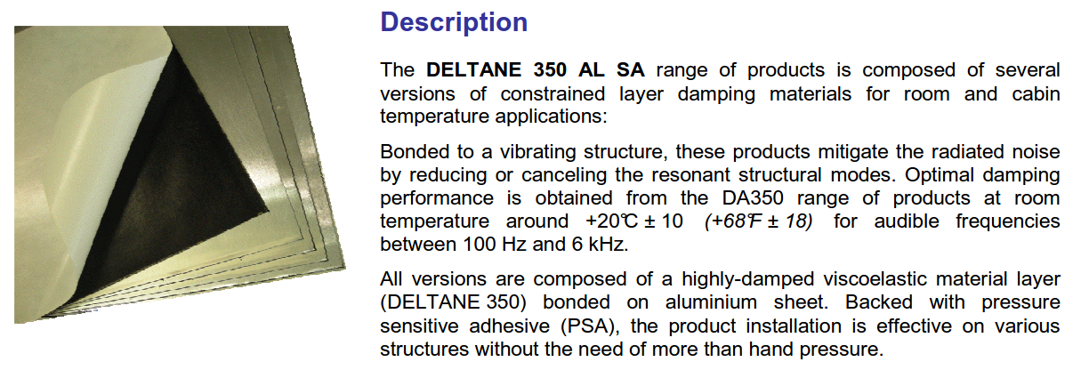
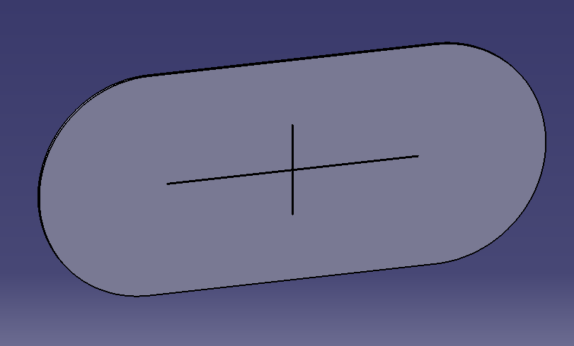
INSULATION STRATEGY & GUIDELINE
Contact:
Gabriel Mallozi
Marc Larochelle Legrand
Eng. Rules Summary: section 2
Phase 1: Requirements and methodology
PG 16, 29 - All slits and minor cutouts will not be modeled and will be done by BA-Production unless known as standard. (ex: electrical provisions (hardware))
It must be done within the limitations of BAPS 730-014 (blankets) and/or Notes (others).
- Clearances slits should never be done through Deltane (PLPXXX type DX ) for wire passage since it is composed of a aluminum sheet.
PG 16, 29 - Attachments of blankets (Velcro's) will not be modeled and will be installed by
BA-Production. It must be done within the limitations of BAPS 730-014 and/or Notes (MBD & DWG)
PG 28 - No seamlines are authorized on blanket, « flextane », « Deltane ». Not recommended neither for felt outsourced since re-attachment and/or re-identification will be an issue. Consult methods.

Slide 41
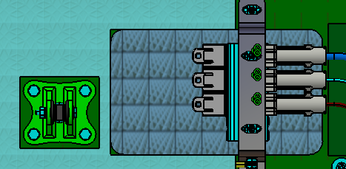
INSULATION STRATEGY & GUIDELINE
Contact:
Gabriel Mallozi
Marc Larochelle Legrand
Eng. Rules Summary: section 2
Phase 1: Requirements and methodology
3D
PG 31 - Only big cutouts which will be reused from one aircraft to the next shall be modeled in MBD. EX: Access panels, tie-rods, etc. If big cutouts “non-standard” is required, create a new number.
- Gap of .125" between parts and blankets cutouts (ex: tie-rods).
-No gap needed for access panels.
PG 12, 13, 33- Use adapted insulation notes for MBDs. Tolerance to be per PLP.
PG 16, 29 - Do not model Velcro, slits, minor non-standard cutouts, drain holes, vent holes covered by BAPS
-*As maturity of product evolve, standard attachments, slits,… may be added to 3D.
PG 29, 37 - Always model blankets « as installed » considering the 1.5% factor but never produce flexible models to « avoid other 3D clash »
PG 29 - No flat pattern to be done on MBD.
PG 29 - Add annotation for identification for « Top » & for « Attachment side ».

Slide 42
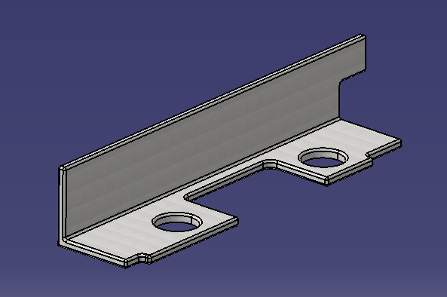
INSULATION STRATEGY & GUIDELINE
Contact:
Gabriel Mallozi
Marc Larochelle Legrand
Eng. Rules Summary: section 2
Phase 1: Requirements and methodology
3D
PG 31 - Limit reduction of thickness.
PG 31 - Use sharp corners and avoid rounded cutouts.
PG 32, 16 - Always consider minimum wall thickness (2’’ Blankets) (.500” Felt)
PG 29 - Do not model edge fillets & beveled end parts (keep 90 deg edges)
PG 34 - Pre-cut should be avoided in blankets, flextane, deltane.
It is possible to create them in felt but should be limited
as much as possible since manual production is very time
consuming. Discussion with methods is required. Marking process under development by M&P.

Slide 43
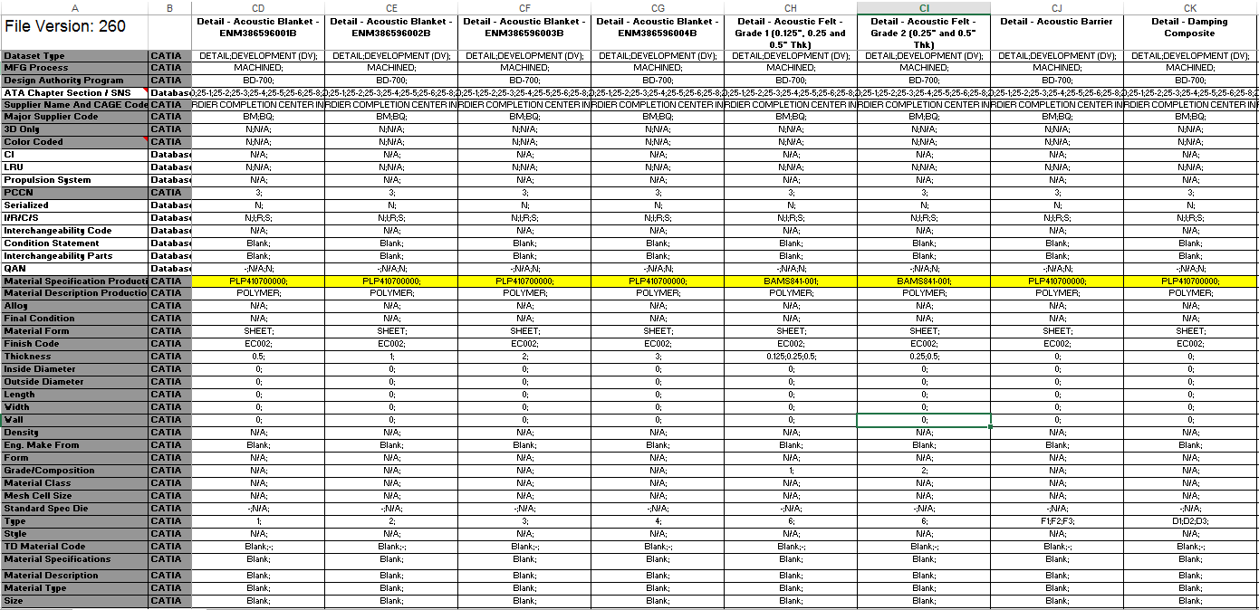
INSULATION STRATEGY & GUIDELINE
Contact:
Gabriel Mallozi
Marc Larochelle Legrand
Eng. Rules Summary: section 2
Phase 1: Requirements and methodology
2D
PG 14,15 - Use adapted insulation notes for installation & follow normal drafting standards.
- Attributes (extracted from attributes check tools, may change without notice)

Slide 44
INSULATION STRATEGY & GUIDELINE
Contact: Sidelegde focal or
Gabriel Mallozi
Marc Larochelle Legrand
Eng. Rules Summary: Section 3
Information:
- Sideledge/Dado methodology used on Demo ACFT is different from information mentioned in this guide. Most of material purchased raw and manufactured in house.
- Sideledge/Dado methodology on NLA & subs in still under development.
Preliminary NLA & subs definition key elements
-1 Dwg with a P/L to identify pieces per sideledge/dado referring to 1 Dwg controlling the
non-standards trimming and cutouts.
(methodology Dwg)
- Separate “cutout & trimming” standard Dwg.
- Revision of material to align with PLP methodology
- Alignment with suppliers on methodology 3D, 2D, attributes, fabrication, process, …
- Revision of notes for methodology Dwg and for future upload in template. (including stitching)
- General clearance tolerance controlled by notes.
EX: .25-.50 from installation,1.50 from LRU (stay-out zone), marking (dotted lines) .250 line profile, …
- Fab-assy for critical velcro located parts
- Extra / non-used parts for some option pattern.
- Tape to cover non-used self-adhesive sections
- Basic shape modeled with “extra” to consider all options. Marked up dotted line
- Alignment with methods & production on internal and external capacities and methodologies.
- Overlaps trimming process for some option pattern.
- Methods cutting boards for options to develop upon production needs.
- …

Slide 45
INSULATION STRATEGY & GUIDELINE
Contact:
Gabriel Mallozi
Marc Larochelle Legrand
On Going Investigation
Information:
- Marking process with permanent marker on felt to replace pre-cuts
- Marking process on Hutchinson material (Blankets, Flextane, Deltane)
- Onboarding of new material and stack up on Hutchinson dwg.
- Revision of BAPS 730-014.
- Sideledge NLA & Subs complete methodology.
- Flammability tests & results.
- Integration of notes into template
- Transfer of guideline into Design Guide
- Lessons learnt from supplier and production
- Continuous improvement of product as maturity of design evolve.
- …

